Slide 1
Internet Search and Beyond

Slide 2
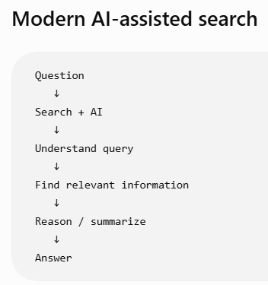
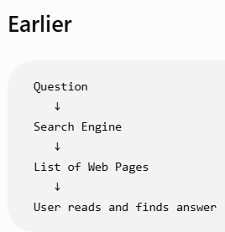
Introduction

Slide 3
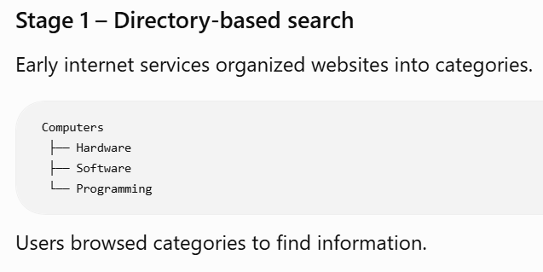
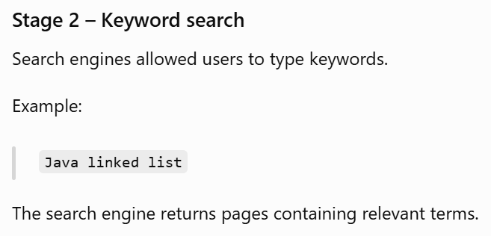
Evolution of Search

Slide 4
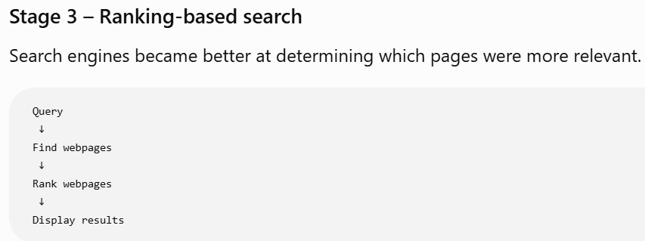
Evolution of Search
Stage 4 – Semantic search
Search engines became better at understanding the meaning and intent behind a query.
For example:
"places to eat near me"
The search engine understands that the user wants restaurants nearby, not webpages containing exactly those words.

Slide 5
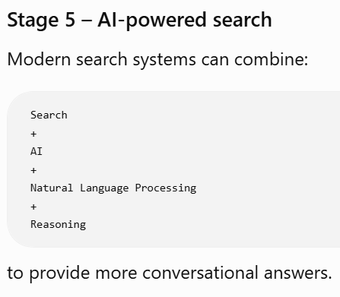
Evolution of Search

Slide 6
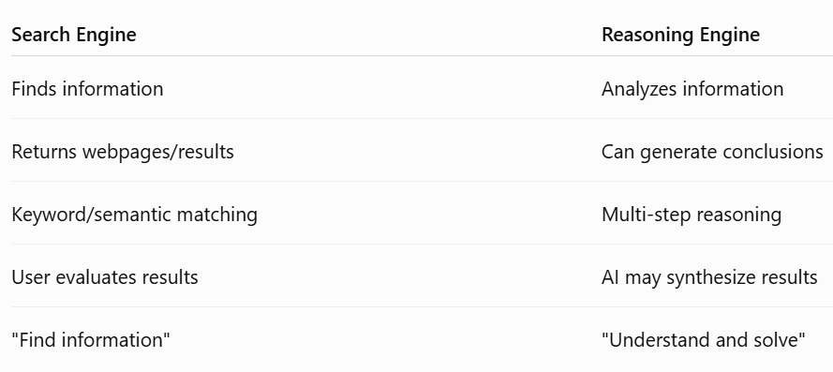
Search Engine vs Reasoning Engine

Slide 7
Microsoft Copilot – A New Way to Search
The user can then ask the follow-up question
This creates a conversation rather than a single search query.

Slide 8
Important Components of a Good Prompt
A useful prompt can contain:
1. Role
Tell the AI what role it should take.
"Act as a computer science teacher."
2. Task
Tell it what to do.
"Explain binary search.“
3. Context
Provide relevant background.
"The students are beginners."
4. Constraints
Specify limitations.
"Use simple language and keep it under 300 words."

Slide 9
Important Components of a Good Prompt
5. Output format
Specify how the answer should look.
"Give the answer as a table."
Combined example
"Act as a computer science teacher. Explain binary search to first-year students who know arrays but not searching algorithms. Use a simple example and present the steps in a table."

Slide 10
Iterative Prompting
You don't always need to create the perfect prompt immediately.
You can improve the response through multiple interactions.
Prompt 1:
Explain AI.
Prompt 2:
Explain AI to engineering students.
Prompt 3:
Explain AI to first-year engineering students using three simple real-world examples.
Prompt 4:
Explain AI to first-year engineering students using three simple real-world examples and present them in a table.

Slide 11
“Critical Thinking”
This is extremely important when using AI.
Critical thinking is the ability to analyze information carefully, evaluate evidence, identify assumptions, and make reasoned judgments.
AI-generated answers should not automatically be assumed to be correct.
AI can produce:
Incorrect information
Outdated information
Misleading information
Incorrect references
Biased information
Hallucinated information

Slide 12
Critical Thinking Questions
1. Is the information accurate?
Can I verify it?
2. Is the source reliable?
Where did this information come from?
3. Is the information current?
Could this information have changed?
4. Is there bias?
Is the response presenting only one viewpoint?
5. Does the evidence support the claim?
Is there sufficient evidence?

Slide 13
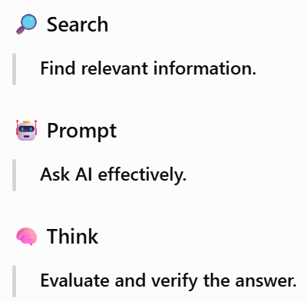
Three Key Skills from This Module

